Slide 1
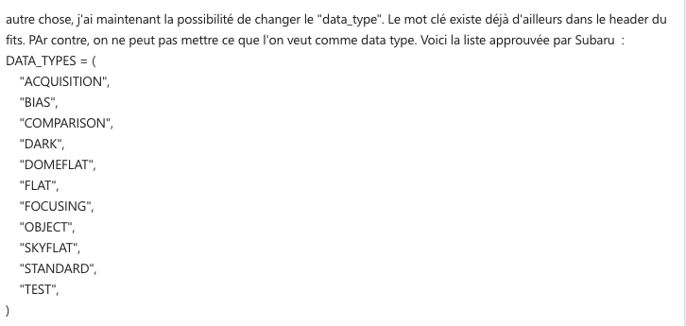
Fits header Keywords:
DATA-CAT = RAW , PREPROC, REDUCED, PIXELMAP, WAVEMAP, COUPLINGMAP
DATA-TYP = WAVE?, OBJECT, DARK, SKYFLAT etc..
DATA-CAT gives the level of reduction:
RAW means raw data from the camera
PREPROC means the data has been cut and compressed
PIXELMAP is the pixel map on the detector
WAVEMAP is the wavelength as a function of pixel
COUPLINGMAP is the position as a function flux
IMAGE is the reconstructed image cube
DATA-TYP gives the type of data
WAVE (or COMPARISON, or STANDARD) is Neon source data
SKYFLAT is sky during the night
DARK is dark images
OBJECT is the night time observation data

Slide 2
RAW Files
PIXEL MAP
runPL_createPixel
runPL
preprocess
Needed
PREPROC Files
COUPLING MAP
WAVELENGTH MAP
runPL_createCmap
runPL_createWave
Needed
runPL
image
Needed
Needed
runPL
spectre
REDUCED Files:
Images
REDUCED Files:
Spectres

Slide 3
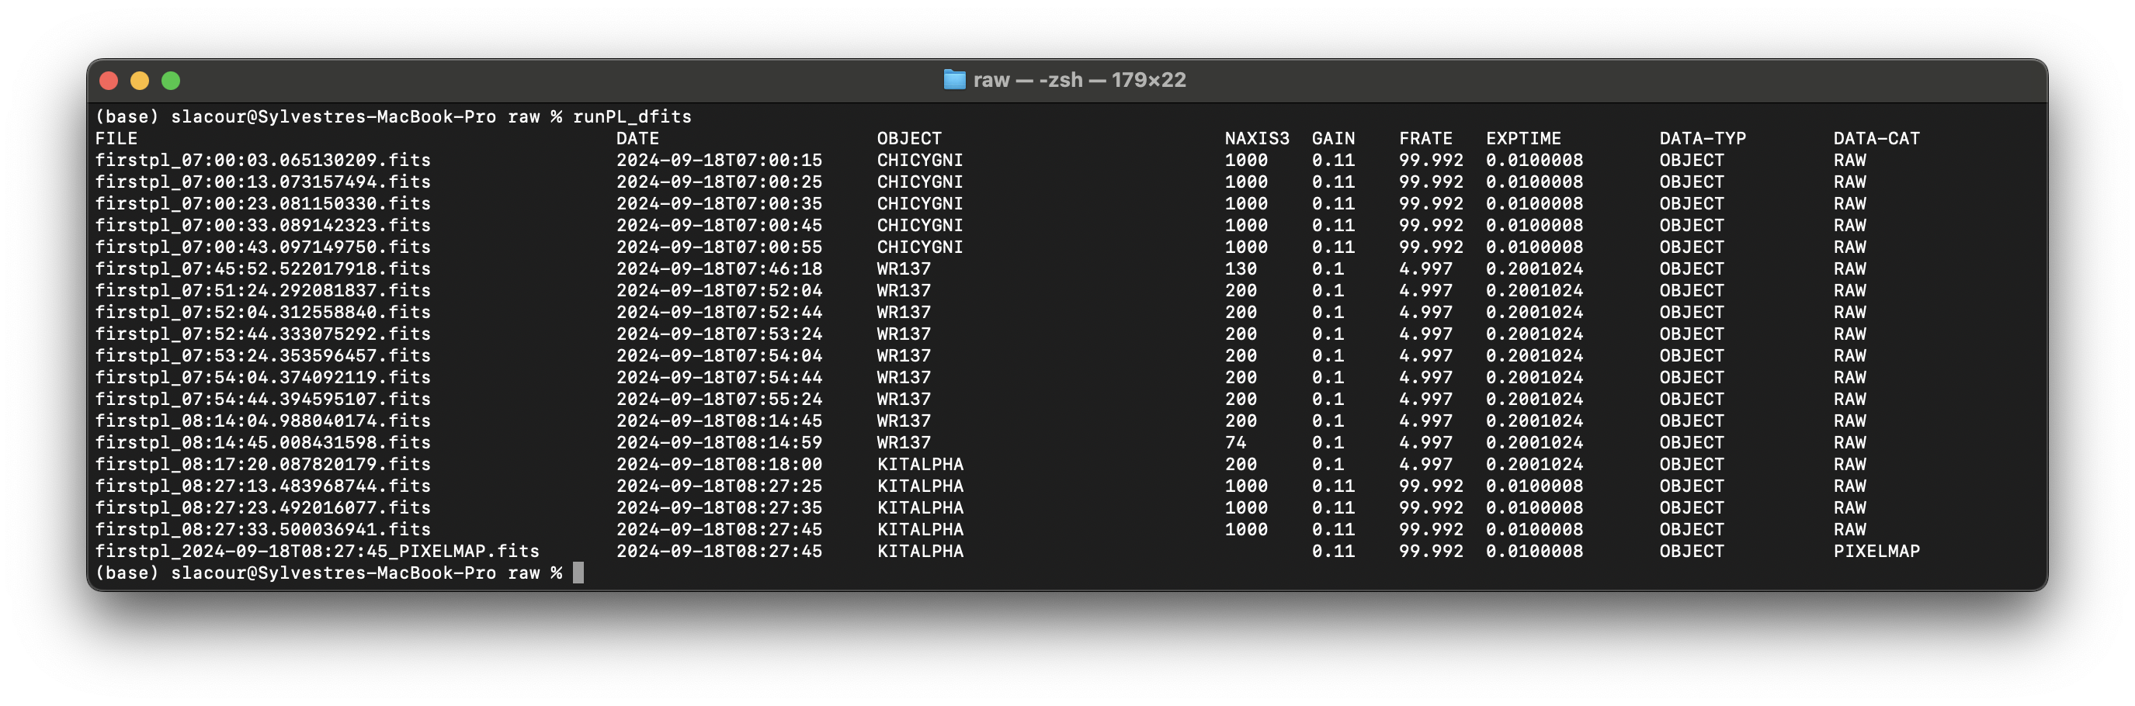
Basic tools
runLP_dfits: shows the important parameters of header:

Slide 4
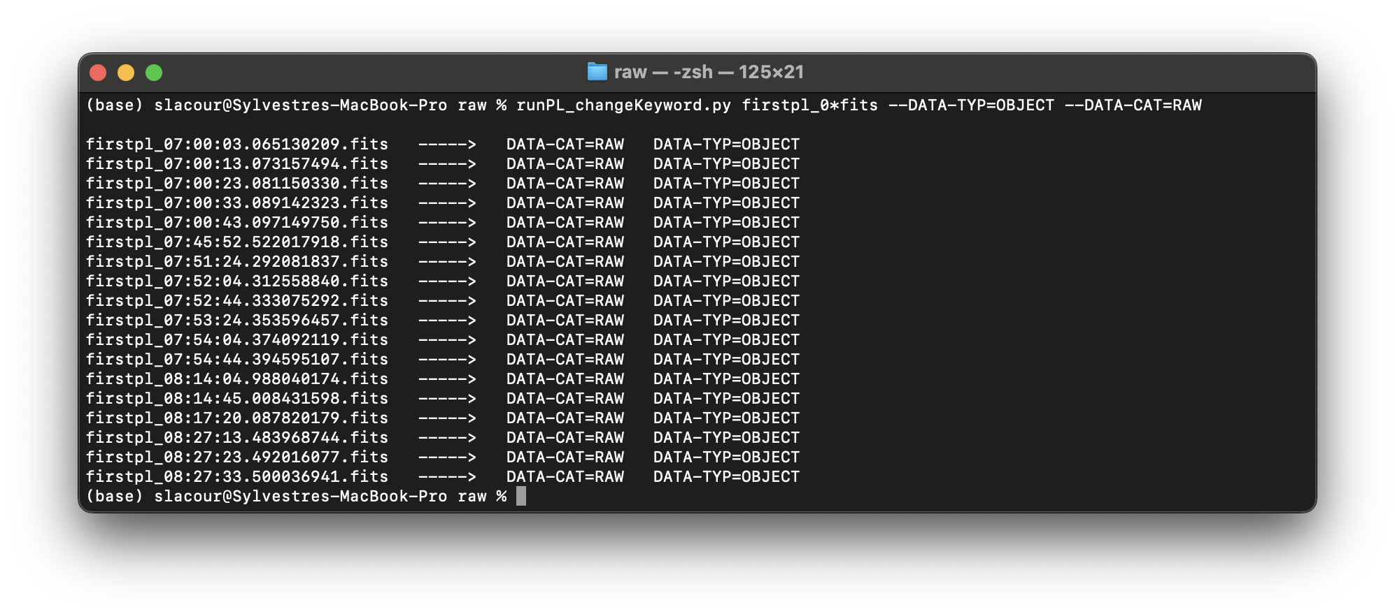
Basic tools
runPL_changeKeyword.py: change the DPR keywords of files

Slide 5
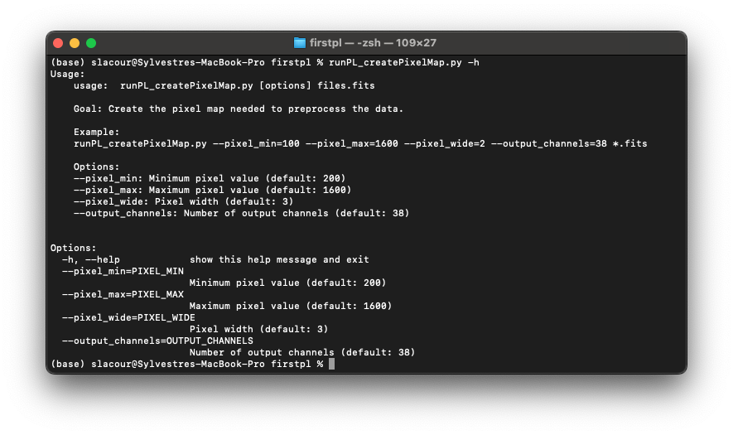
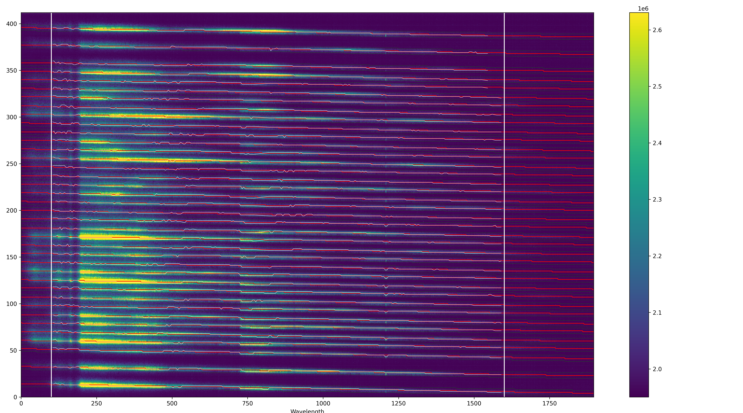
PREPROC tools
runLP_createPixelMap.py: create a file “firstpl_PIXELS.fits” file from any directory of RAW data.Also create a png:
White lines are position of the peaks found and used for the fit of the window:

Slide 6
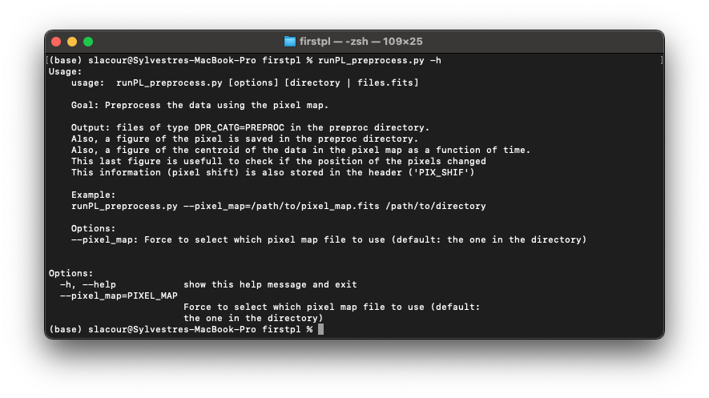
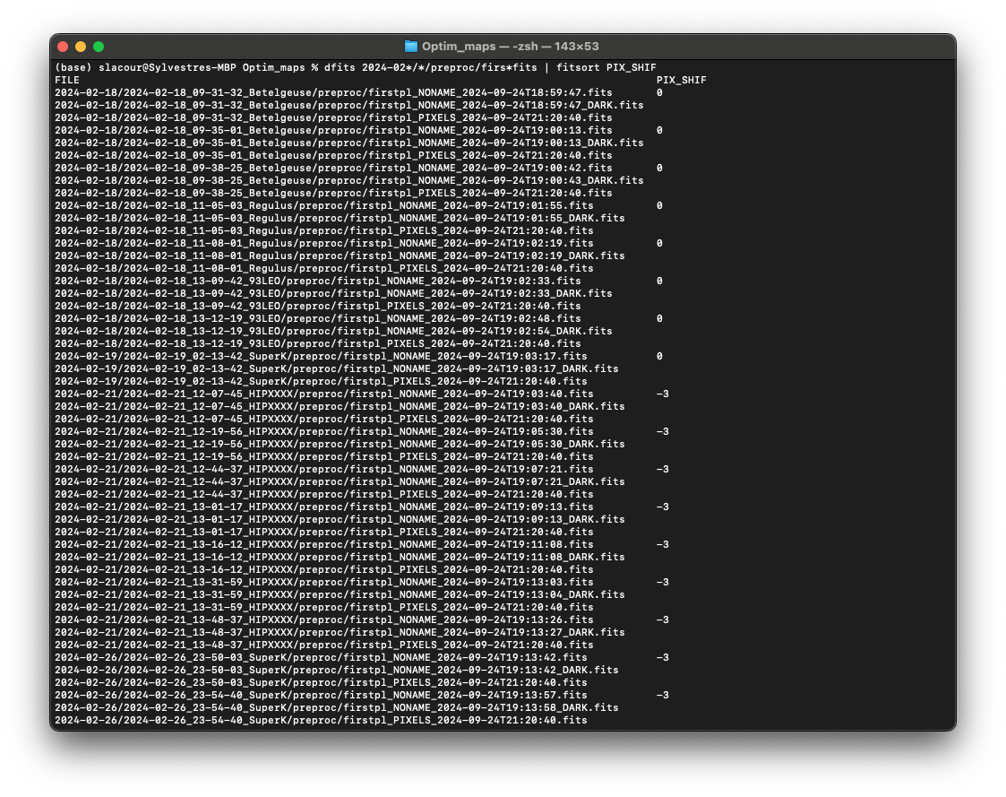
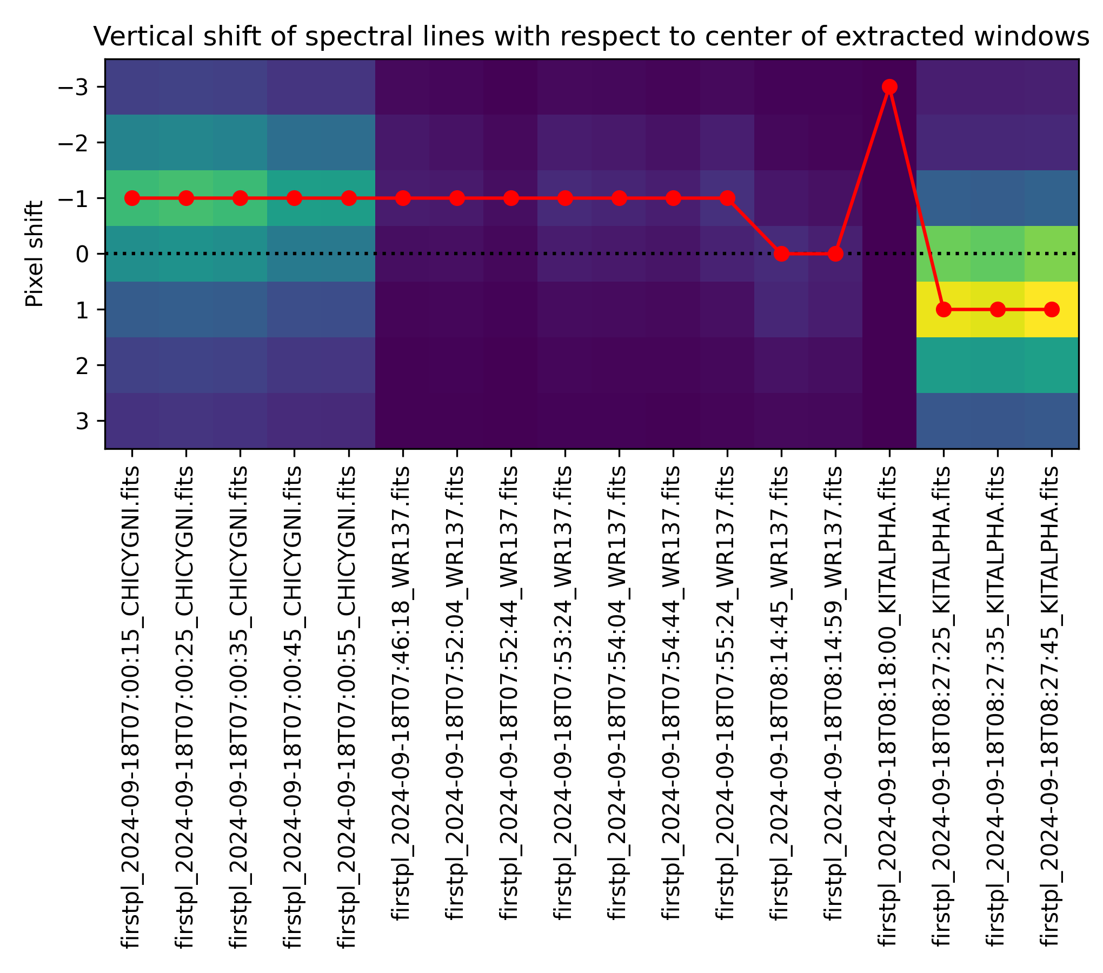
PREPROC tools
runPL_preprocess.py: Cut the RAW data, output the data in the preproc directory, plus 2 plots
Also compute vertical shift ➔

Slide 7
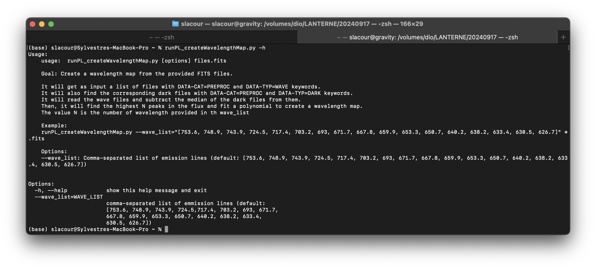
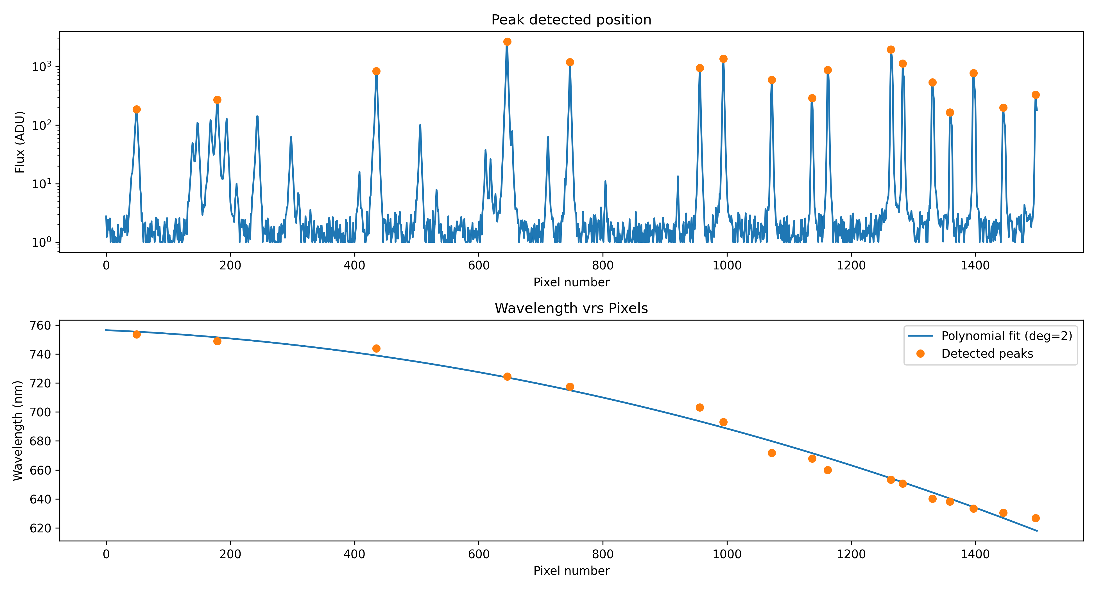
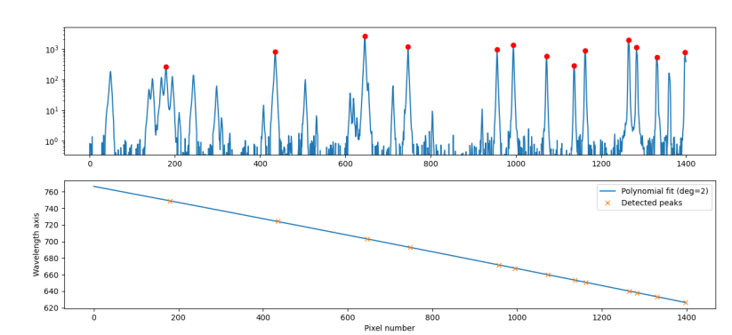
R TTo do: automatic checking of the good peaks: start with a list of 18 peaks. Find the 15 biggest. Check which one are found over the 18th….
runPL_createWavelengthMap.py
Good
Bad

Slide 8
REDUCE tools
runPL_createCouplingMap.py: create a fits files with the coupling map matrices

Slide 9
REDUCE tools
runPL_createCouplingMap.py: create a fits files with the coupling map matrices

